Slide 1

K. K. Wagh Polytechnic, Nashik. Hirabai Haridas Vidyanagari, Amrutdham, Panchavati, Nashik-422003 Department of Computer Technology
‘‘
A Holistic Approach to Campus Recruitment and Student Profile Analysis for Placement
”
Guide name: Mr. S. H. Sangale
Group Members:
Kalyani Hemant Bangar
Aditya Arun Dhakane
Shraddha Punjaram Gaidhani
Ashwini Ashok Salunke
CP- 04

Slide 2
CONTENTS
Sponsors Details
Introduction to Project
Project Plan
Literature Survey
Proposed Project Concept
Functional Requirements
Project Design and Analysis
Advantages and Disadvantages
Applications
References and Conclusion

Slide 3
Sponsor Details
Name: K. K. Wagh Polytechnic, Nashik | Name: Mr. P. M. Mohan
Address: Hirabai haridas vidyanagari, Amrutdham, Panchvati, Nashik - 422003 | Designation: TPO Officer
Office Phone No: 253 2512876 | Mobile No: 9421229303
E-mail ID: principal-poly@kkwagh.edu.in | E-mail ID: pmmohan@kkwagh.edu.in

Slide 4
INTRODUCTION
The system is introduced to bridge the gap between education and the job market. It addresses challenges faced by students and employers during the transition from academic to the professional world.
The system uses data-driven analysis to create student profiles, helping students understand their strengths And employers identify suitable candidates efficiently.
It takes a holistic approach to recruitment, and placement emphasizing practical skills and industry readiness.
This system signifies a commitment to job-ready graduates and fostering collaboration among students, institutions, and employers.

Slide 5
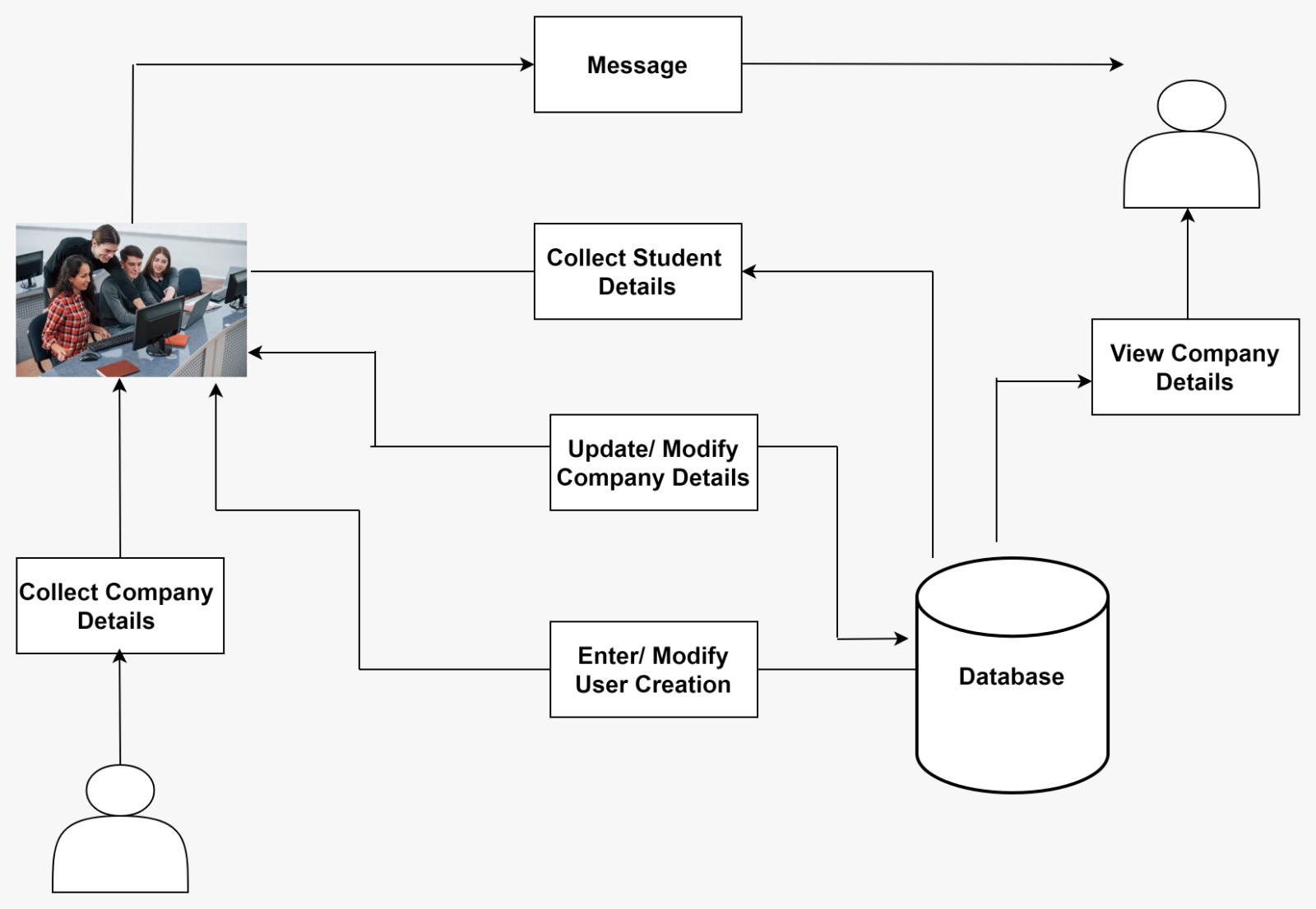
Structural Diagram

Slide 6
Project Plan
Task | Description | Days Required
Task 1 | Searching For Project Definition | 08
Task 2 | Preparing and Submitting Synopsis | 04
Task 3 | Requirement Gathering and Validation | 06
Task 4 | Risk Analysis and Management | 03
Task 5 | UML Modelling (Detailed Design) | 03
Task 6 | Developing Test Cases | 05
Task 7 | Preparing and Submitting Report | 06
Task 8 | Delivering Presentation | 01

Slide 7
Literature Survey
Research Paper 1: Online Training and placement system.
Authors: Gunjan Jewani , Swati Sahare , Trupti Kamble , Ritu Kathalkar, Ashwini Unhale
Description: This provides a user-friendly registration system. This online portal plays a pivotal role in bridging the communication gap between students, coordinators, and recruitment professionals by providing timely updates on placement-related activities. Additionally, it enables students to store information about their education, career goals, and skills.
Research Paper 2: TNP portal using web development and machine learning.
Authors: Prasad Khalkar, Aditya Muthal, Sujit Khopade, Lokesh Ghule, Prof. Tushar A. Rane
Description: Companies visit campuses to identify potential candidates and qualities in the vast student data. Predictive placement for engineering students starting early can guide their development. An interface simplifies job applications, saving time. It uses predictive analytics and machine learning to assess a student's placement likelihood in various industries.

Slide 8
EXISTING SYSTEM
Online Training and placement system is a portal which plays a pivotal role in bridging the communication gap between students and recruitment professionals by providing timely updates on placement-related activities. To make student’s aware of career opportunity.
In colleges the records were stored in excel sheets hence sorting the data is always a problem. Updating Records is another tedious task.
The files were not stored in a hierarchical format, hence searching the eligible students was the greatest problem.
The placement officer has to find out the eligible students by looking at the excel sheet. They have to see the marks of every student and their eligibility.
There is also a large communication gap between students and the placement officers as it is difficult to maintain coordination between them.

Slide 9
Proposed Project Concept
The ICRPT is a comprehensive software solution that connects educational institutions, students, and potential employers.
It centralizes the student placement process, offering skill enhancement, job opportunities, and guidance for students while enabling efficient recruitment for employers.
It ensures security and integrity during assessments through features like video and audio recording and employs modern web technologies for a user-friendly experience.
The user will be assessed based on the Assessment test, which includes Audio, video & MCQ question based on that the user will be analyzed.

Slide 10
Algorithm Used
The Big Five model of Personality :
The Big Five model of Personality test is a valuable tool for hiring managers to assess potential employees' personality traits before they start their job.
It evaluates individuals on five key dimensions: Openness to Experience, Conscientiousness, Extraversion, Agreeableness, and Neuroticism collectively abbreviated as The Big Five model of Personality .
By understanding where candidates fall on these personality scales, employers can tailor their interview questions and evaluation processes to predict how individuals may perform in various work situations.
This insight enables more informed hiring decisions, enhancing the likelihood of successful and productive employees from day one.

Slide 11
Project Functionalities.
User can Create their Accounts.
Approval/disapproval of requests of Companies.
View, Delete Student & Job list
Students can Apply for the Job.
HR Can hire Students based on the skills required .
Admin can track the progress of students.
Admin dashboard.
Student dashboard.

Slide 12
Functional Requirements.
The system should allow users to register and create an account.
It should be able to take skill assessments and receive personalized recommendations for training and job opportunities.
The should include a questionnaire/assessment tool to evaluate the student's performance.
The system should be able to continuously update its database of Users to keep track of their progress.
The system should allow student’s to share their assessment results and progress reports on their profile. This feature facilitates communication and collaboration between job seeker and the providers, ensuring a coordinated approach for placement.
It should be able to Establish partnerships with universities, colleges, and vocational training canters to integrate student data and facilitate collaboration.

Slide 13
Project Design and Analysis
Data Flow Diagram
A Data Flow Diagram (DFD) is a visual tool used in system analysis and design to show how data moves within a system for managing student profiles and job placements. It involves some external entities. Data stores maintain student profiles, job postings, matched profiles, applications, and placement records.

Slide 14
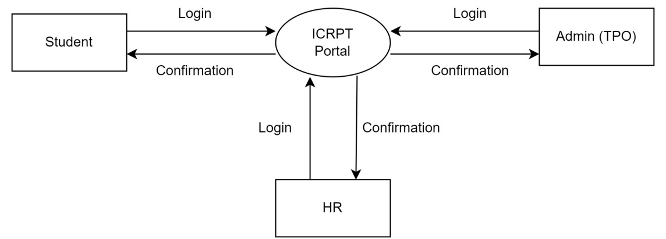
DFD-LEVEL: 0

Slide 15
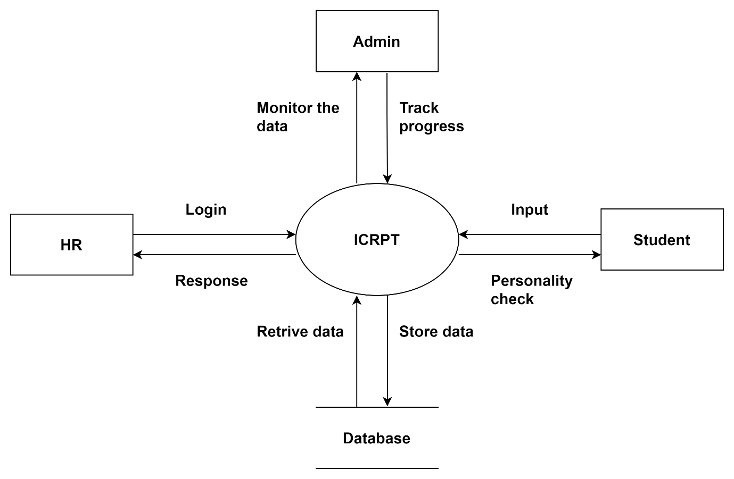
DFD-LEVEL: 1

Slide 16
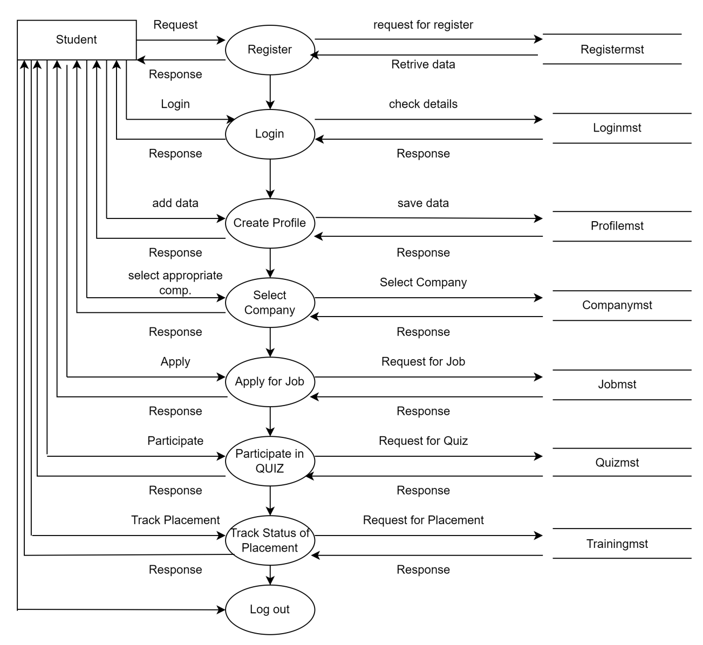
DFD LEVEL 2: STUDENT

Slide 17
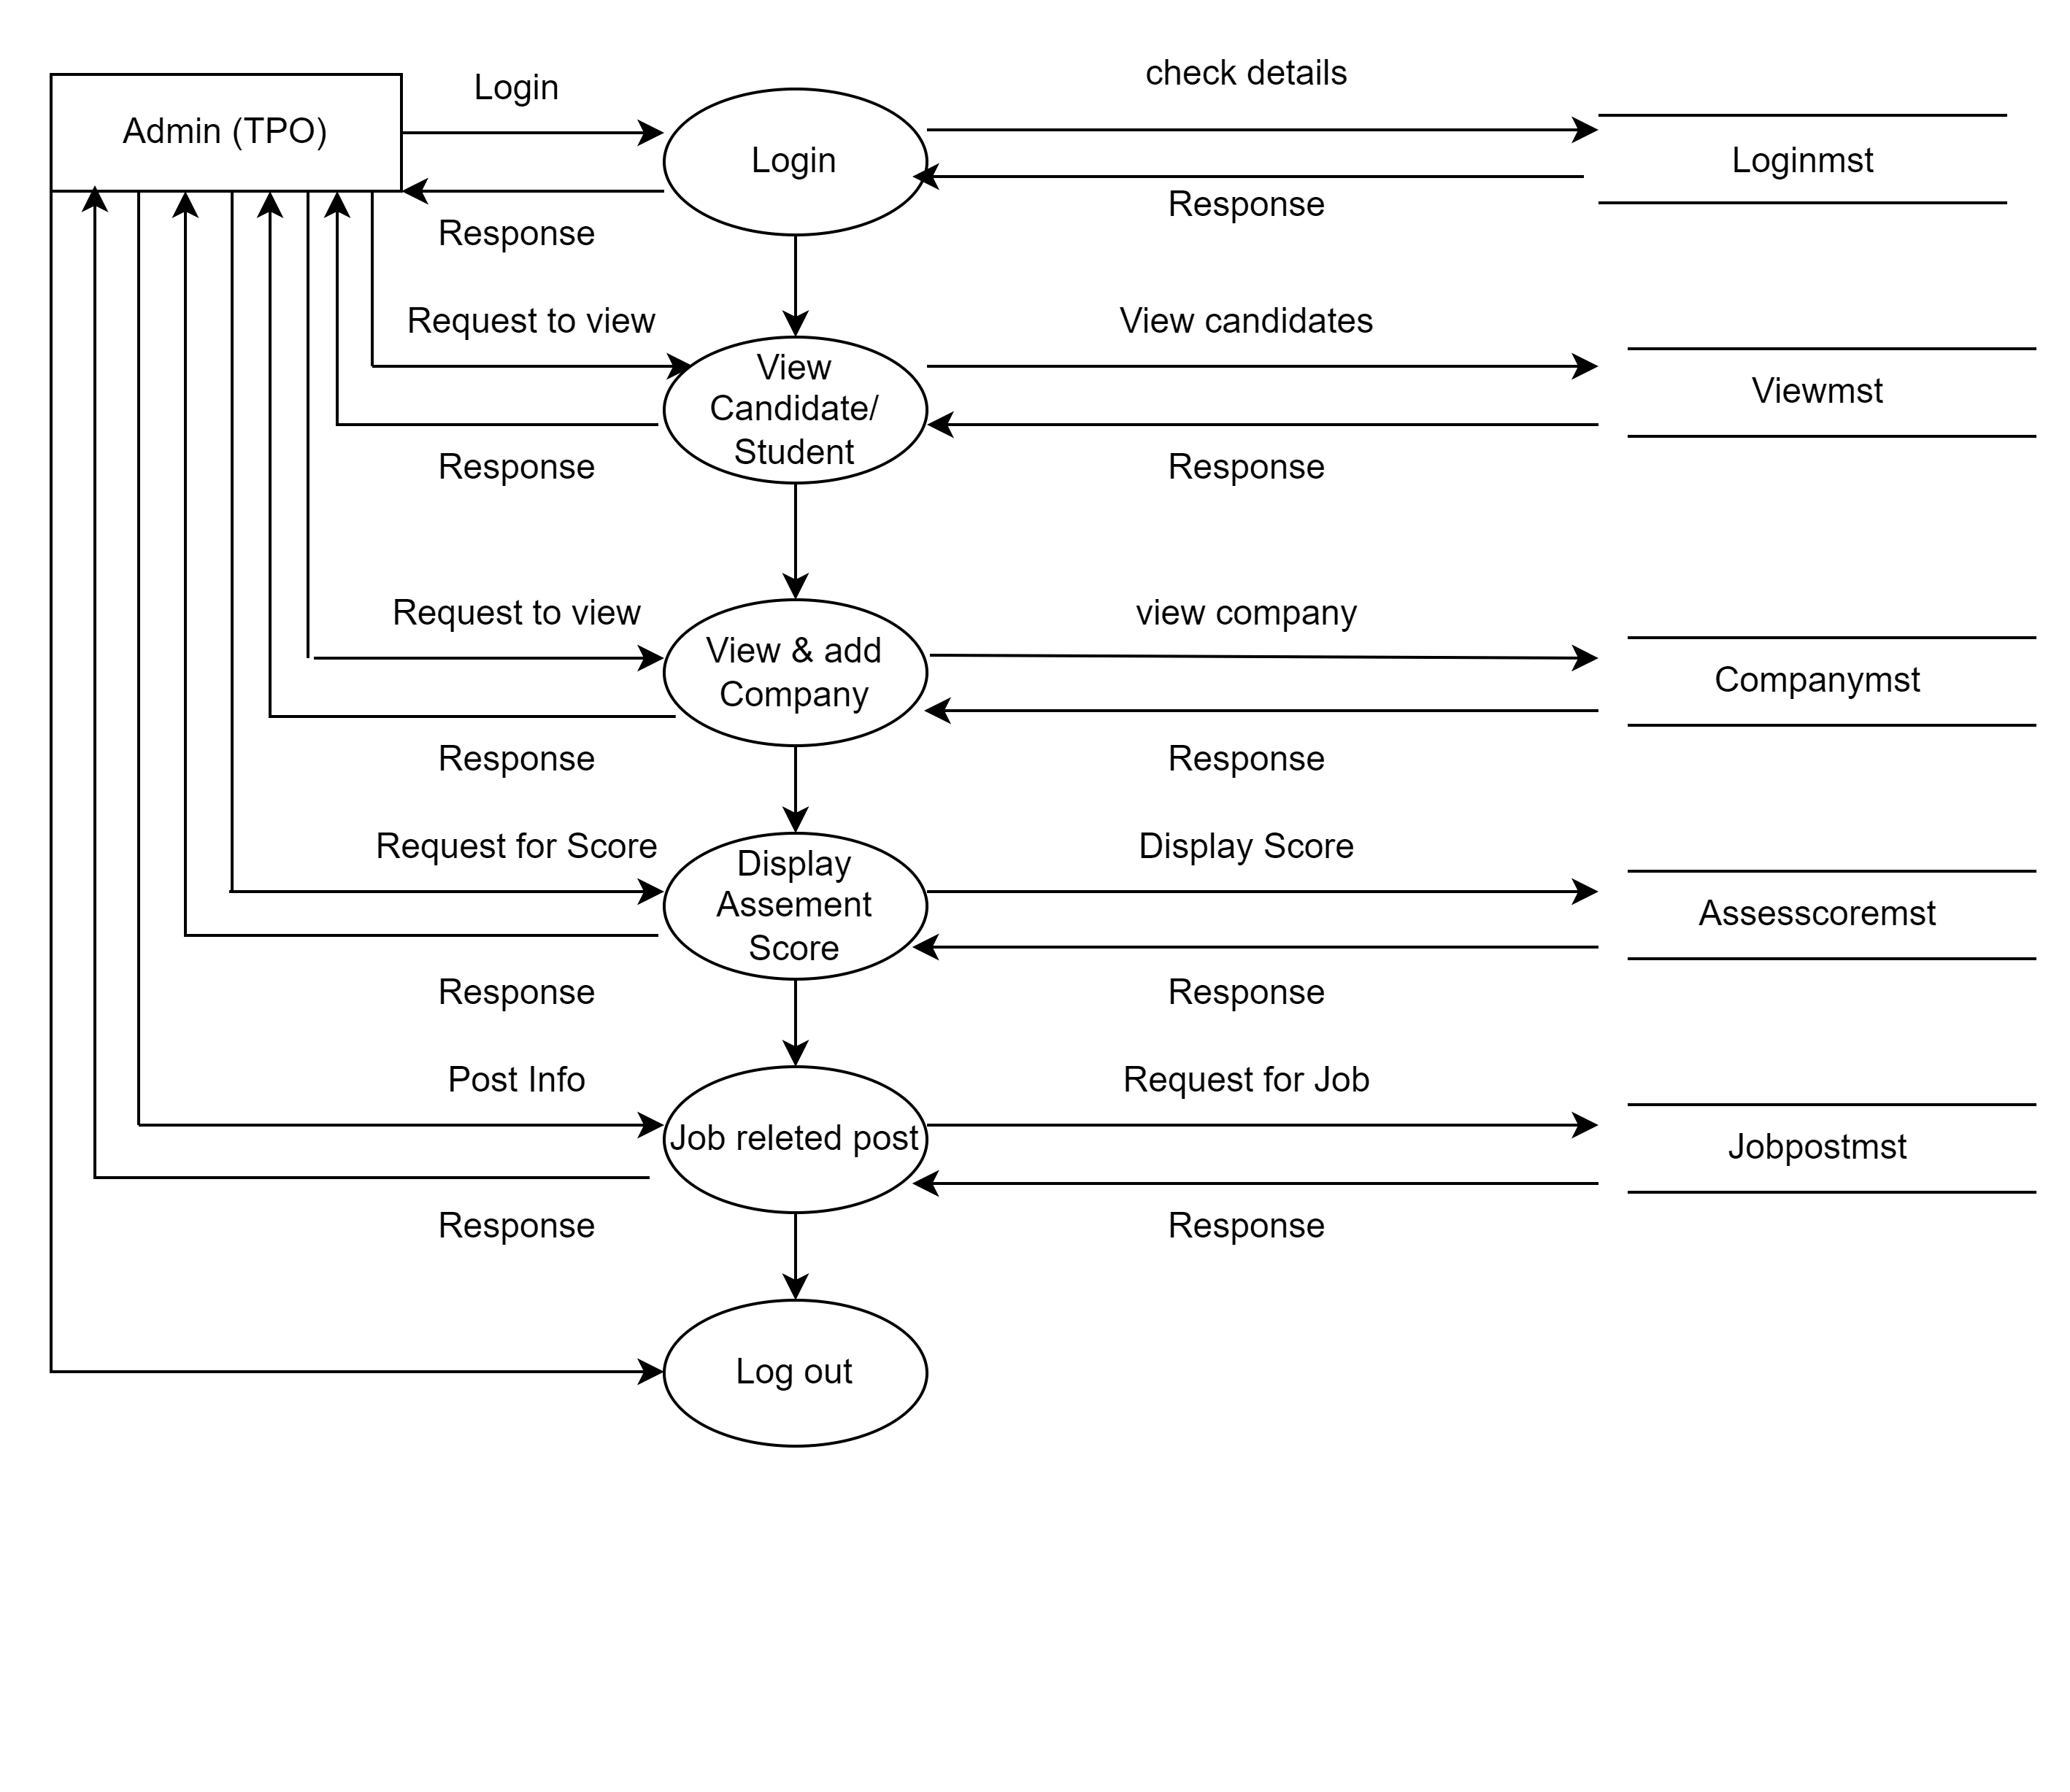
DFD LEVEL 2: ADMIN

Slide 18
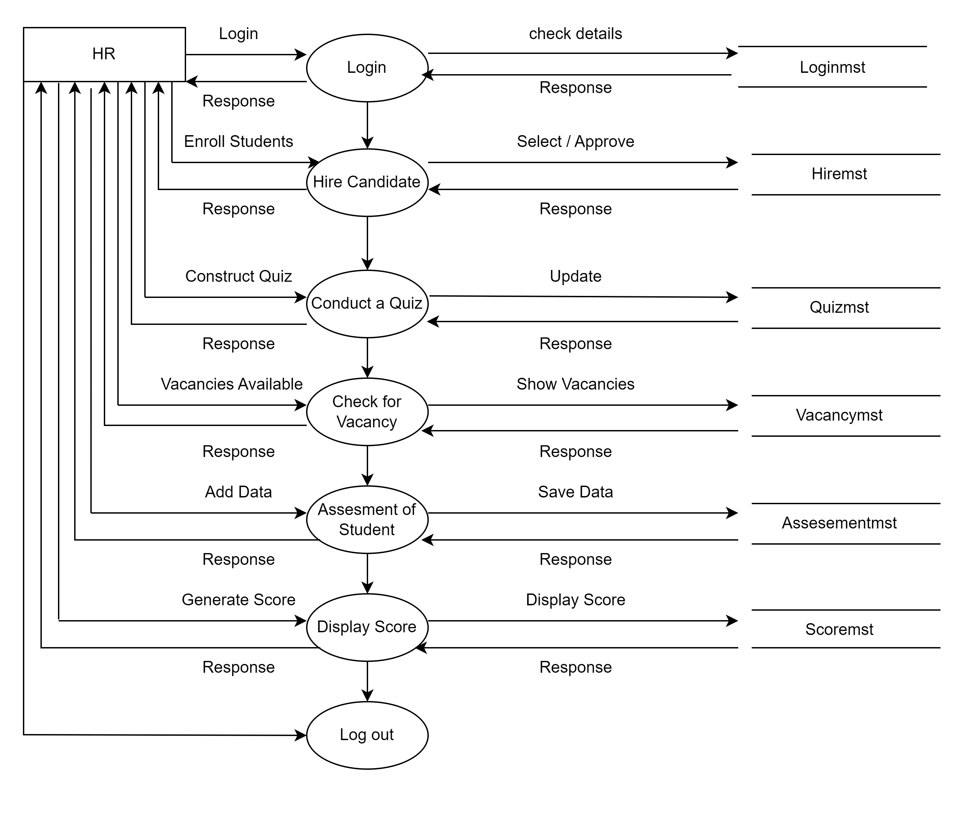
DFD LEVEL 2: HR

Slide 19
Activity Diagram
An Activity Diagram is a visual representation used in system modeling to illustrate processes and workflows.
Activity diagrams aid in requirements analysis, making them a valuable tool for clarifying and formalizing system or process requirements.
In our project, where students are central, an activity diagram outlines the sequence of key actions. It commences with student registration and job searching, etc. This diagram visually illustrates the complete student journey within the portal, aiding in process optimization and user experience enhancement.

Slide 20
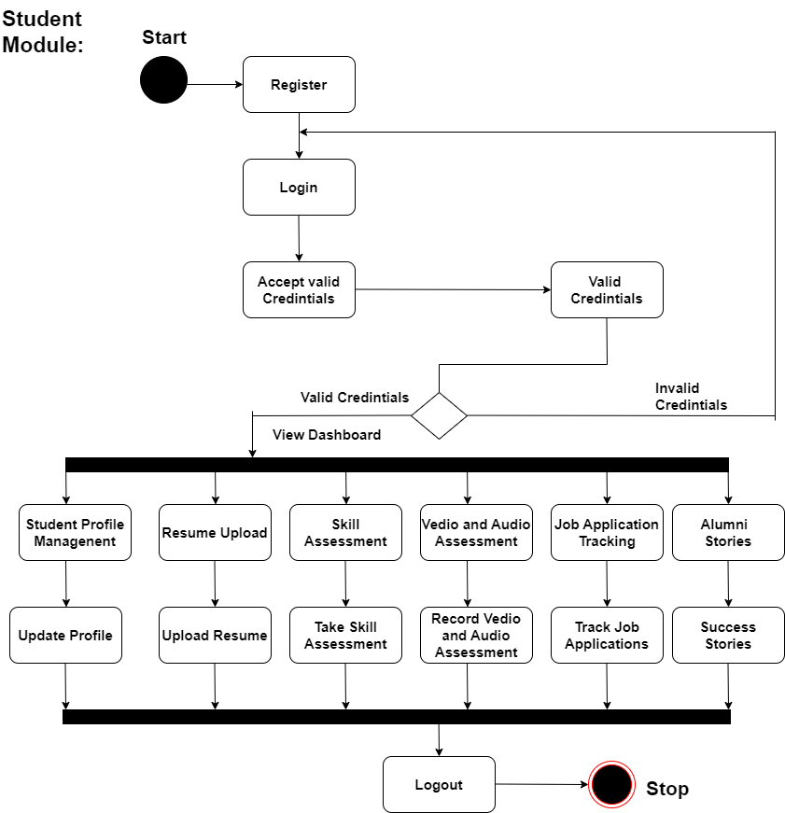

Slide 21
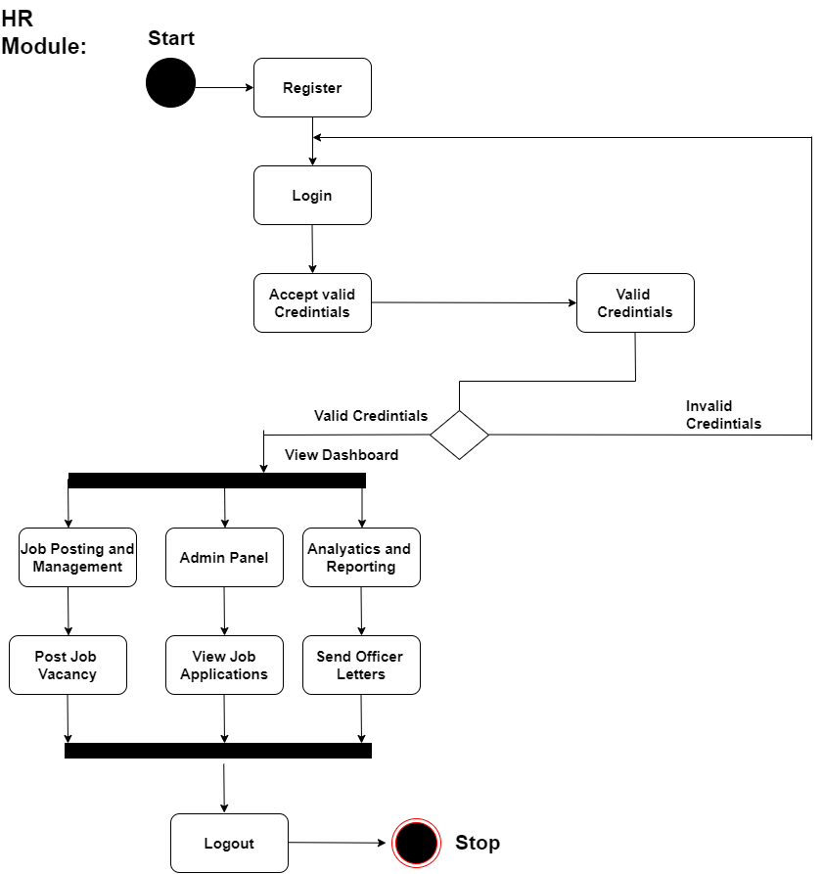

Slide 22
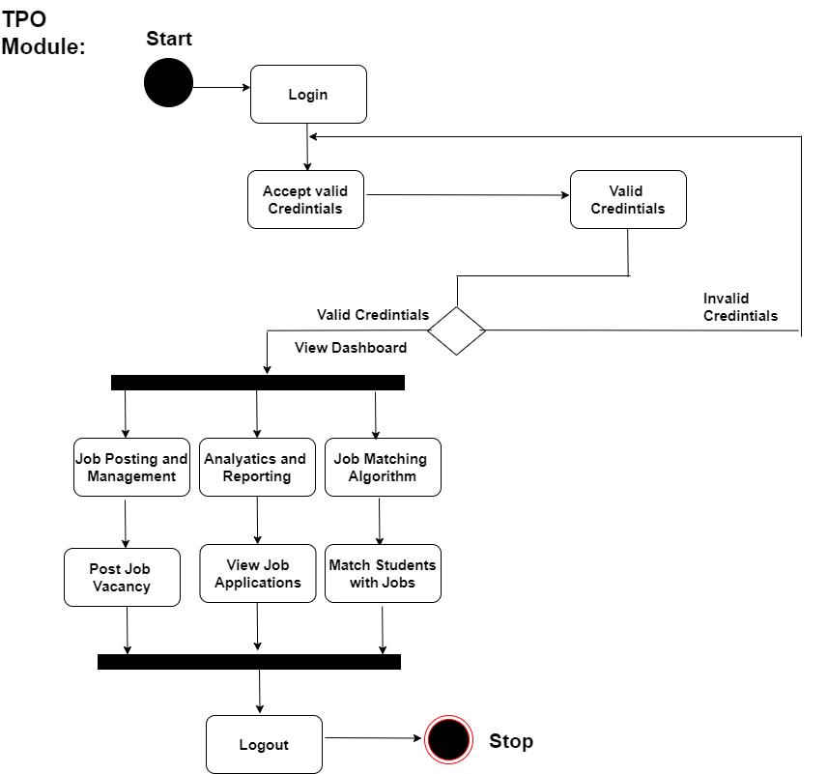

Slide 23
Use Case Diagram
In our project Portal Use Case Diagram, there are three main actors: students, employers, and admin.
Students can log in, search for jobs, and apply, while employers can log in, post job vacancies, review applications, and schedule interviews.
The admin oversees the system, managing user accounts and resolving disputes.
This diagram visually represents how these actors interact with the portal's features, offering a concise overview of the system's functionality for training and job placement processes.

Slide 24
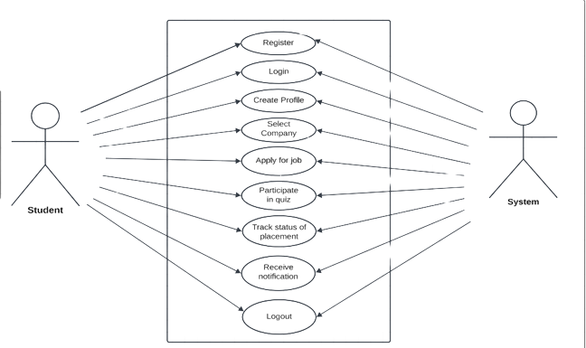
Use Case: Student

Slide 25
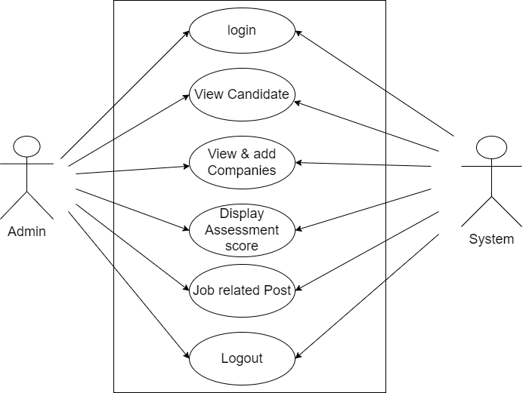
Use Case: Admin(TPO)

Slide 26
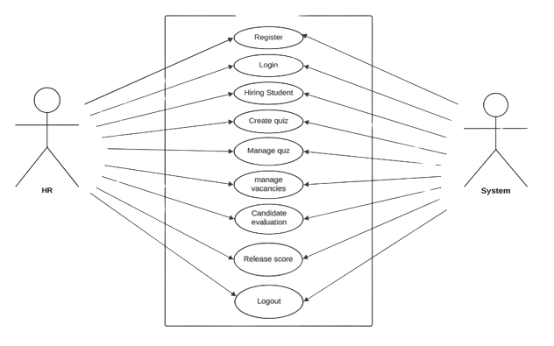
Use Case: HR

Slide 27
Advantages and Disadvantages.
Job Matching Algorithm
Skill Assessment
Job Application Tracking
Student Profile
User Authentication
ADVANTAGES

Slide 28
DISADVANTAGES
Advantages and Disadvantages.
Limited job Opportunities
Limited Reach

Slide 29
Applications
Education institutions
Corporate organizations
Government initiatives
Start-ups and small Businesses
Global employment

Slide 30
References
D. K. Arun, V. Namratha, B. V. Ramyashree, Y. P. Jain and A. Roy Choudhury, "Student Academic Performance Prediction using Educational Data Mining," 2021 International Conference on Computer Communication and Informatics (ICCCI), Coimbatore, India, 2021.
T. R. Kumar, T. Vamsidhar, B. Harika, T. M. Kumar and R. Nissy, "Students Performance Prediction Using Data Mining Techniques," 2019 International Conference on Intelligent Sustainable Systems (ICISS), Palladam, India.
Gunjan Jewani , Swati Sahare , Trupti Kamble , Ritu Kathalkar , Ashwini Unhale Assistant Professor, Computer Science and engineering, Jhulelal Institute Of Technology Nagpur, India ” Online Training and Placement System” 2023 IEEE International Students’ Conference on Electrical, Electronics and Computer Science

Slide 31
Conclusion
Integrated campus recruitment, placement and training analysis (ICRPT) emerges as a transformative solution that bridges the gap between learning and professional opportunities. This dynamic system, designed to cater to educational institutions, organizations, and individuals alike, has the potential to reshape how we approach training, placement, and skill development.

Slide 32
THANK YOU

